Slide 1

classes
CitiusTech has prepared the content contained in this document based on information and knowledge that it reasonably believes to be reliable. Any recipient may rely on the contents of this document at its own risk and CitiusTech shall not be responsible for any error and/or omission in the preparation of this document. The use of any third party reference should not be regarded as an indication of an endorsement, an affiliation or the existence of any other kind of relationship between CitiusTech and such third party

Slide 2
Structure of a class…
class Class_name
{
constructor
{ }
type static_variable_1;
type instance_variable_1;
type instance_variable_2;
type method_name_1(parameter_1,…….)
{ method body }
type method_name_2(parameter_1,…….)
{ method body }
}

Slide 3
The class
The “class” is use to represent the Entity in form of Code (Progarmme).
A class can have two types of members….
1) Data Member
2) Function Member
Relation Map between Entity And “class”
ENTITY class
STATE
DATA MEMBER
BEHAVIOUR
FUNCTION MEMBER

Slide 4
Eample( CLASS )…… KEYWORD
class Account
{
int Account_Bal ;
String Name ; DATA MEMBER
char Account_Type;
void account_Bal()
{
// code to get the account balance.
}
Void deposit()
{
// code for deposit the amount .
FUNCTION MEMBER
}
void withdraw()
{
// code for deposit the amount .
}
}

Slide 5
class Account
{
int Ac_Bal;
String name;
void getAcBal()
{
System.out.println(Ac_bal) ;
}
void getName()
{
System.out.println(name);
}
}
Entity Design
class Test
{
public static void main(String s[])
{
Account atm=new Account();
atm.Ac_Bal=1000;
atm.name =“JAI”;
atm.getAcBal();
atm.getName();
}
}
Using entity through “Object”

Slide 6
class 1
class n
class 2
main ( )
class 3
class 5
class 4

Slide 7
Creating multiple objects
class Test
{
public static void main(String s[])
{
Account atm1=new Account();
Account atm2=new Account();
atm1.Ac_Bal=1000;
atm1.name =“JAI”;
atm2.getAcBal();
atm2.getName();
}
}
Account
ATM1
Account
ATM2

Slide 8
Assigning object to Reference variable
class Test
{
public static void main(String s[])
{
Account atm1=new Account();
Account atm2; //reference variable
atm2 = atm1;
atm1=NULL;
atm2.name =“JAI”;
atm2.getAcBal();
atm2.getName();
}
}
ATM1
Account
ATM2

Slide 9
Adding Parameter to method
class Math
{
int area;
void getArea (int a , int b)
{
int area = a*b;
System.out.println(“area = “ +area);
}
}
class Test
{
public static void main(String s[])
{
Math b=new Math();
b. getArea(10,20);
}
}

Slide 10
Returning value
class Math
{
int area;
int getArea (int a , int b)
{
int area = a*b;
return area;
}
}
class Test
{
public static void main(String s[]) // main function
{
Math b=new Math();
int result = b. getArea(10,20);
System.out.println (result); // using System class.
}
}

Slide 11
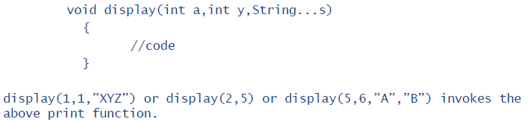
Method with Variable Argument List

Slide 12
Method overloading
class FunctionOverload
{
void add(int a, int b)
{
int sum = a + b;
System.out.println(\"Sum of a+b is \"+sum);
}
void add(int a, int b, int c)
{
int sum = a + b + c;
System.out.println(\"Sum of a+b+c is \"+sum);
}
void add(double a, double b)
{
double sum = a + b;
System.out.println(\"Sum of a+b is \"+sum);
}
void add(String s1, String s2)
{
String s = s1+s2;
System.out.println(s);
}
}
class OverLoading
{
public static void main(String[] args)
{
FunctionOverload obj = new FunctionOverload();
obj.add(1,2);
obj.add(1,2,3);
obj.add("Life in “,”UK”);
obj.add(11.5, 22.5);
}
}

Slide 13
Constructors
Constructors are use to initialize object .
Name of constructor should be same as name of the class.
Constructor can takes arguments.
No return type. Type of Constructor:
Constructor without parameter
Parameterized Constructor Note : Java provides a default constructor and its initialize data member of the class with default values.

Slide 14
class Student
{
String sid , sname;
Student()
{
sid=“01”;
sname=“herry”;
}
Student(String id ,String name)
{
sid=id;
sname=name;
}
Student(Student obj)
{
sid=obj.sid;
sname=obj.sname;
}
void show()
{
System.out.println(sid+ “ ”+sname);
}
class Example
{
public static void main(String s[])
{
Student ob=new Student();
Student ob1=new Student(“12”,”ram”);
Student ob2=new Student(ob1);
}
}
Note : if we have parameterized constructor in class and we want to use default constructor the we have to define a default constructor in class.
( constructor overloading )

Slide 15
“this” keyword
Use to refer the current object. class Square
{
int height;
int width;
Square(int height, int width)
{
// Note that constructor variable and instance variable names are same
this.height = height;
this.width = width;
}
}

Slide 16
Static
static keyword can be applied to method , class or member variable inside a class.
Static member can be accessed before object creation with the help of class name.(as main is static)
Rules:
Static can access only static.
Non static also can access static.
Static can’t access non static.

Slide 17
Static initializer block : as we have constructors for instance data members ,for static data member we have static initializer block.
class Example
{
int nst;
static int st;
Example() { nst =1000; }
static
{
st=100;
}
void static show()
{
//
}
}

Slide 18
Final
A variable ,method and class can be declared as final.
If a data member is final its treated as constant.
If a method is final it can’t be override.
If a class id final it can’t be inherit. final class Test // can’t be extends {
final int a = 50; // can’t be changed
final m1() { } // can’t be override
}

Slide 19
Access specifiers
public
can access any where
private
can access within class
protected
can access within package and subclasses
default
Package level access

Slide 20
Memory Management
Java Virtual Machine (JVM) de-allocates memory allocated to unreferenced objects during the garbage collection process.
Garbage Collector:
Runs in the background when JVM starts.
Collects all the unreferenced objects.
Frees the space occupied by these objects.
Call System.gc() method to “hint” the JVM to invoke the garbage collector.
There is no guarantee that it would be invoked. It is implementation dependent.

Slide 21
System Class
Cannot be instantiated.
Contains a methods and variables to handle system I/O.
Facilities provided by the System class:
Standard input
Standard output
Error output streams

Slide 22
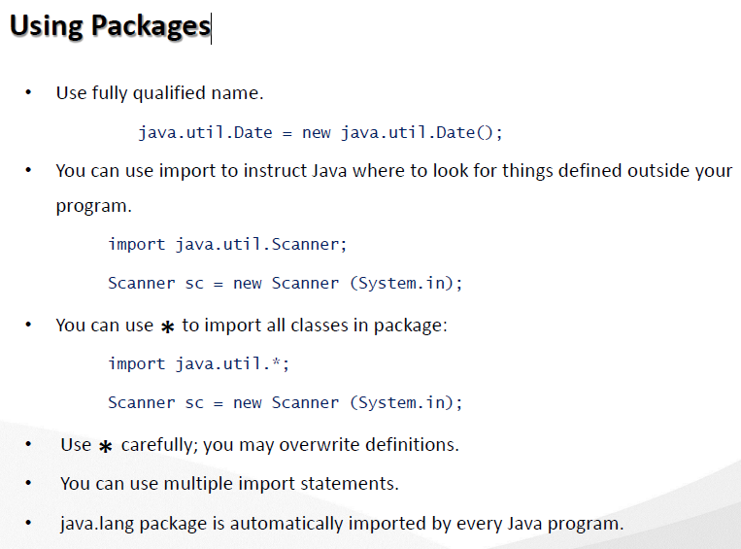
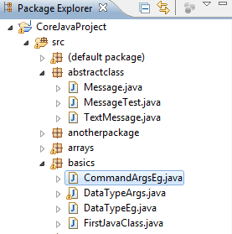
Packages
In Java, by the use of packages, you can group a number of related classes and/or interfaces together into a single unit.

Slide 23
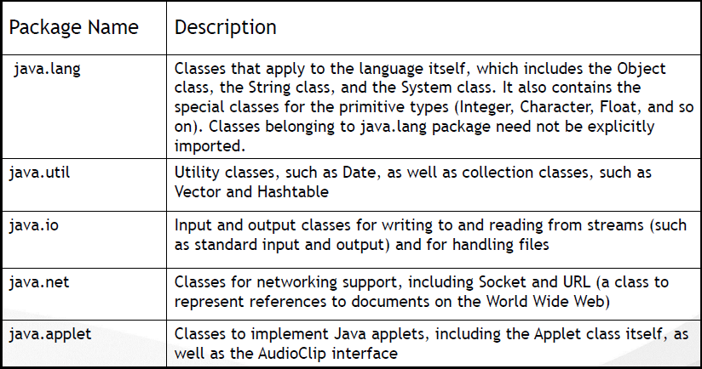
Some Java Packages

Slide 24
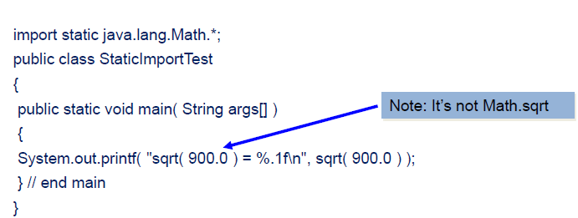
Static Import
Static import enables programmers to import static members.
Class name and a dot (.) are not required to use an imported static member

